Slide 1
Recommending the bicycle lane for Reduction of bicycle accident
Minjun lee

Slide 2
Introduction & Background
Nowadays there are many people who ride bicycle in Seoul(Korea). Actually, releasing ‘Ttareungi’ service from Seoul administration, the people who ride bicycle is increasing. And, also the bicycle accidents tent to increase. even if the rider would be careful, the unsuspected accidents will be happened. To solve this problem, It needs to facility for safety of the rider. So, Seoul administration will install the Bicycle Lane for the safety of the rider. But it’s hard to decide the place where should be installed, where should be begun and where should be finished. To decide the place where is put Bicycle Lane, we will use the Data that include the number of accident, location, the number of victims of bicycle accident from 2012 ~ 2018 years.

Slide 3
Data acquisition and cleaning
the Data of bicycle accidents can be found in “TAAS Caraccidents System” that is open source data center. if you want to reach this data, follow this link “http://taas.koroad.or.kr/”. this data is quite preprocessed, so we can save the time to preprocessing data.
After downloading data, we will make table. but there are a lot of unnecessary columns in this data. we will drop the ID columns, code columns, polygon code column because it is unnecessary. and we will change the column names from korean to english for you guys who cannot read korean. the last cleaning is the dropping rows that have other citys’ accidents

Slide 4
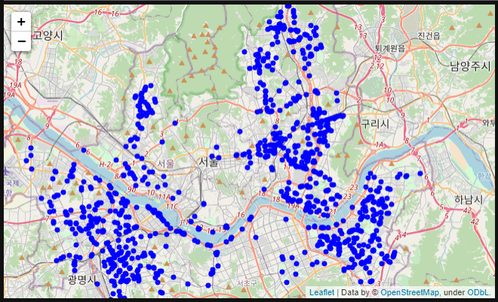
Using Scatter Plot
it is the marker that the accident are happened, not the number of the accident.

Slide 5
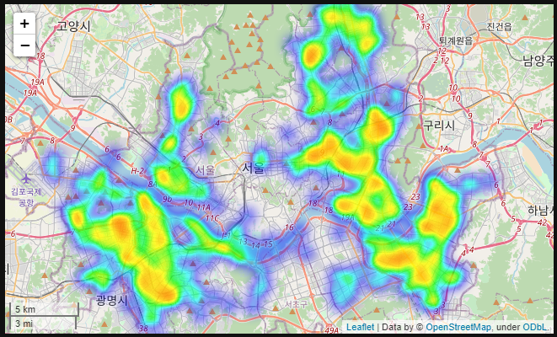
Using Geo-HeatMap
we could find the region Songpa-gu, Gwangjin-gu, Yeongdeungpo-gu, Dongdaemun-gu, Jungnang-gu thoes are concentrated on the Accident.

Slide 6
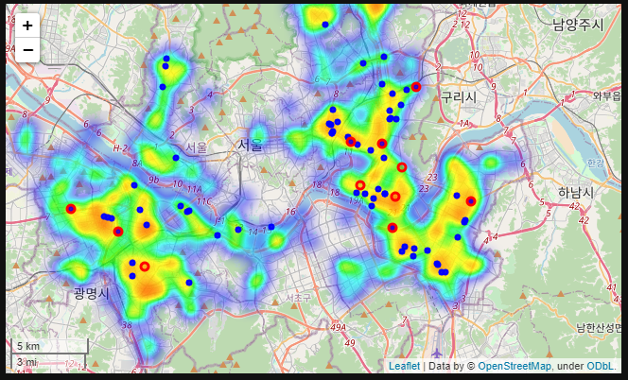
Adding Markers
Extracting the data that is the location happend more than 9 accidents. And it was added in Geo-HeatMap.
( Blue Circles are those Location )
I checked the Data that location happen the serious injuries more than 5 times. it had also found at same location.
( Red circles are those Location )

Slide 7
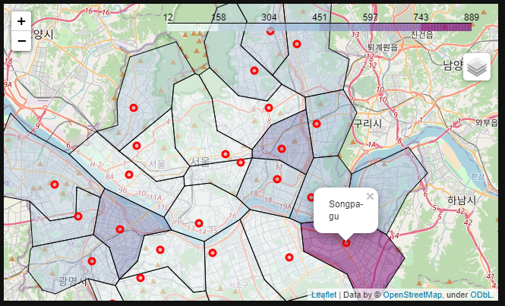
Using Choropleth Map
Choropleth Map to find the most common region at accident.
then we could find the Songpa-gu is the most common region obviously.

Slide 8
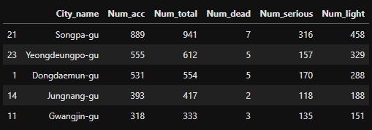
Extracting Top 5 for 8 years

Slide 9
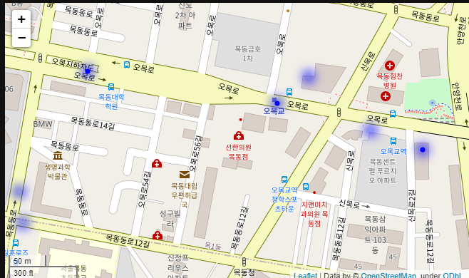
Conclusion
There were some times accident in same street but these are different part of street. (Like next photo)
It is recommended to install the bicycle lane along with that street. it is efficient and economical to install the bicycle lane. And definitely, it helps to reduce the ratio of bicycle accident.

